Slide 1
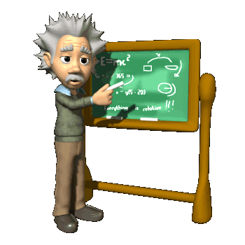
Chapter 6 Integration Techniques (积分技巧)
In this Chapter, we will know some important concepts.
Integration by Parts (分部积分)

Slide 2
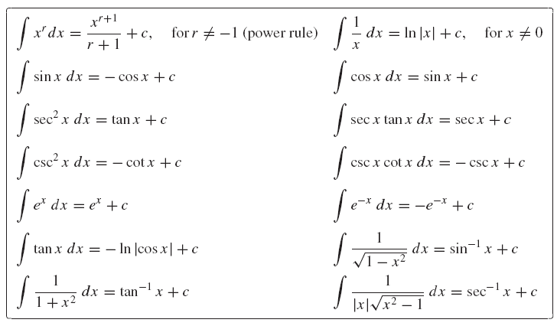
Section 6.1 Review of Formulas and Techniques

Slide 3



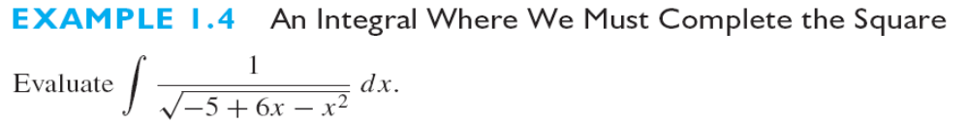

Slide 4
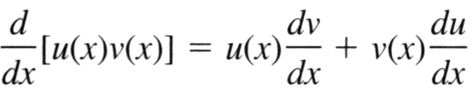
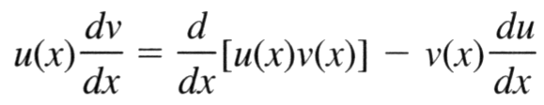

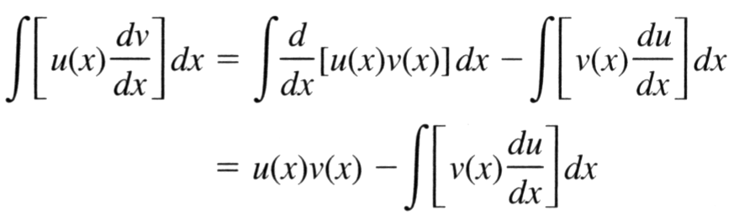
Section 6.2 Integration by Parts (分部积分)
If u(x) and v(x) are both differentiable functions of x, then
Since u(x)v(x) is antiderivative of and

Slide 5
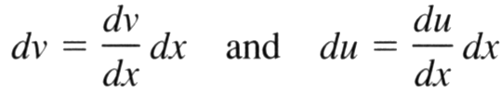
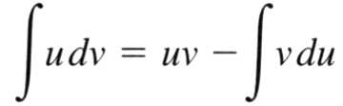
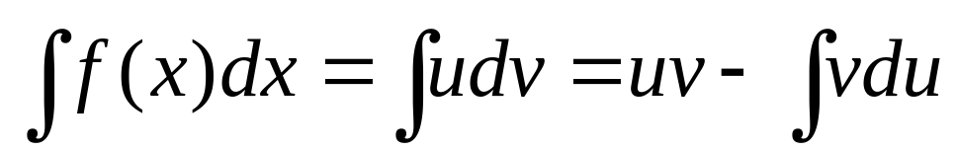
Since
We have
Integration by parts formula:

Slide 6
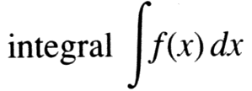
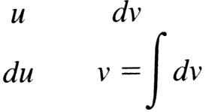
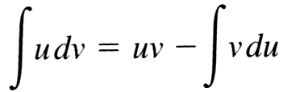
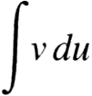
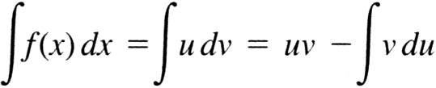
Integration by parts:
Step 1. Choose functions u and v so that f(x)dx=udv. Try to
pick u so that du is simpler than u and a dv is easy to integrate
Step 2. Organize the computation of du and v as
and substitute into the integration by parts formula
Step 3. Complete the integration by finding Then

Slide 7
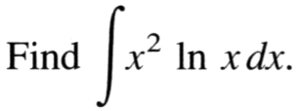
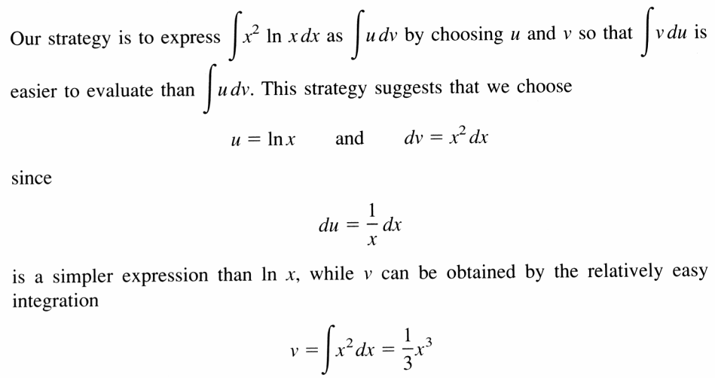
Example
Solution:
to be continued

Slide 8
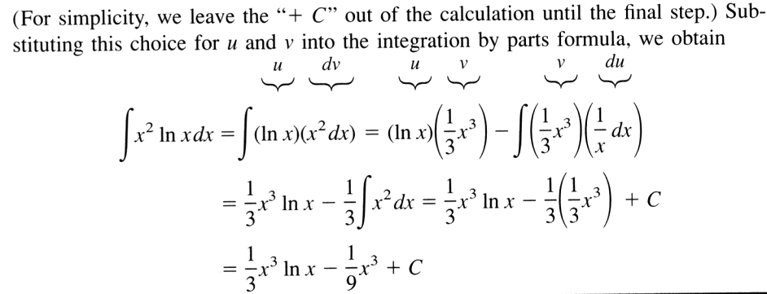

Slide 9

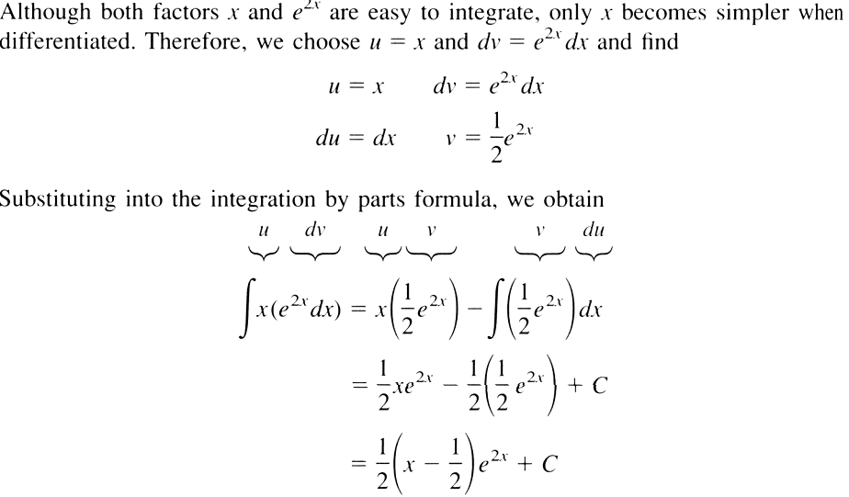
Example
Solution:

Slide 10
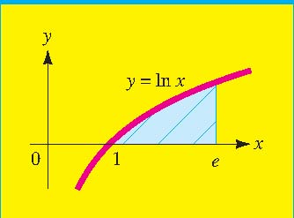
Example
Find the area of the region bounded by the curve y=lnx, the x axis,
and lines x=1 and x=e.

Slide 11
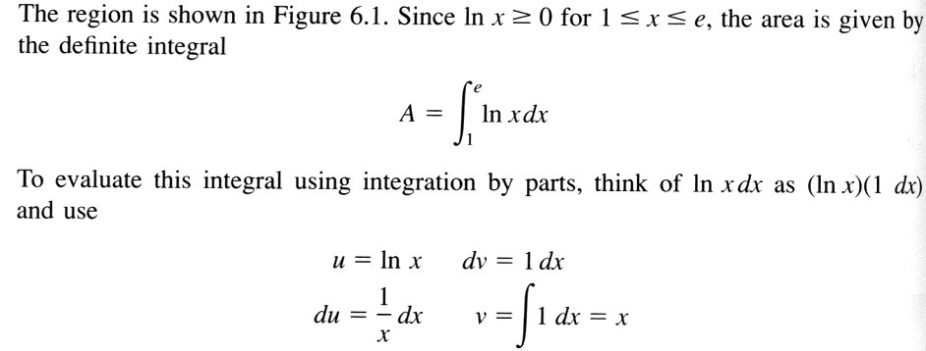
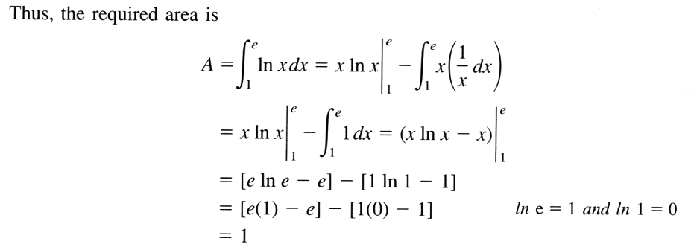
Solution:

Slide 12

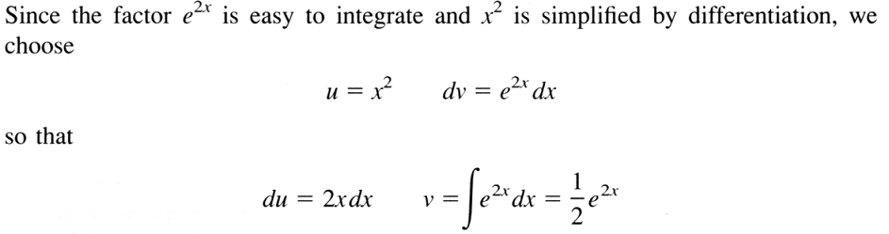
Repeated Application of Integration by parts
Example
Solution:
to be continued

Slide 13
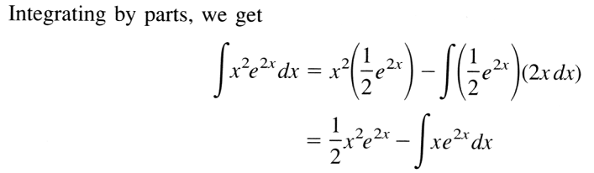
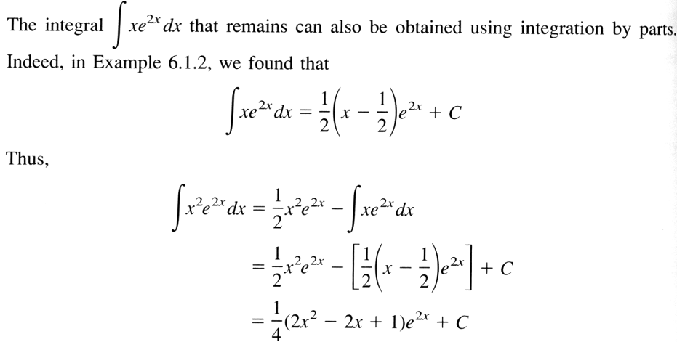

Slide 14
